Slide 1
Domain Name System
7/23/2020

Slide 2
The overall number of domains registered, by TLD type
Type of TLD | Number of TLDs | Domains registered | Signed zones | Upcoming deletes
New gTLDs | 1,248 | 62,839,600 | 302,681 | 6,416,786
Generic TLDs | 8 | 198,747,533 | 3,278,842 | 7,391,689
Country TLDs | 315 | 148,821,163 | 3,815,035 | 1,831,826
All TLDs | 1,571 | 410,408,296 | 7,396,558 | 15,640,301
Source:domainnamestat.com/

Slide 3
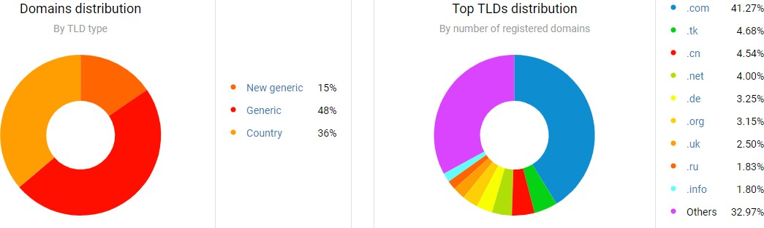
Source:domainnamestat.com/

Slide 4
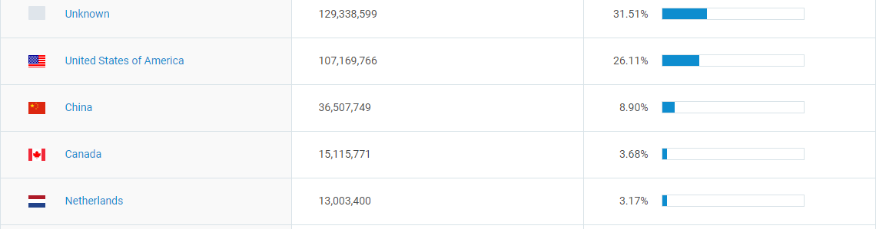
Top 5 Domain name registrations, by the country
Source:domainnamestat.com/

Slide 5



Slide 6










TOPICS
Need for DNS Name Spaces
DNS in the Internet Resolution
DNS Messages
Types of Records Registrars
DDNS
Security of DNS

Slide 7

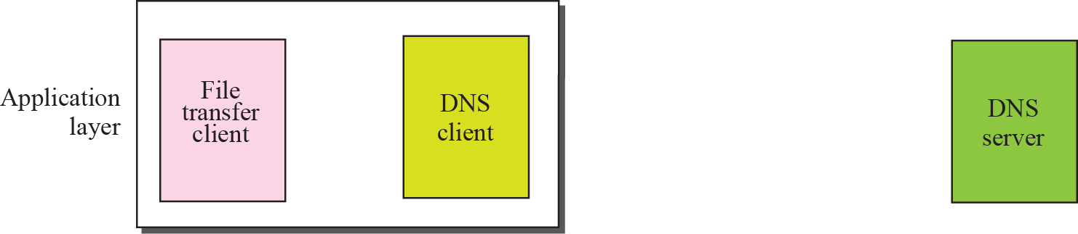





PURPOSE OF DNS
User
1
Host name
Host
₂ name
5
IP address
6
IP address
3
Query
Response
4
Transport layer

Slide 8
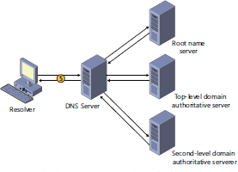
DNS ARCHITECTURE

Slide 9
NEED FOR DNS
To identify an entity, TCP/IP protocols use the IP address, which uniquely identifies the connection of a host to the Internet.
However, people prefer to use names instead of numeric addresses.
Therefore, we need a system that can map a name to an address or an address to a name.

Slide 10
NAME SPACE
To be unambiguous, the names assigned to machines must be carefully selected from a name space binded between the names and IP addresses.
In other words, the names must be unique because the addresses are unique.
A name space that maps each address to a unique name can be organized in two ways:
Flat
Hierarchical

Slide 11
NAME SPACE
Flat Name Space
Hierarchical Name Space
Domain Name Space
Distribution of Name Space

Slide 12
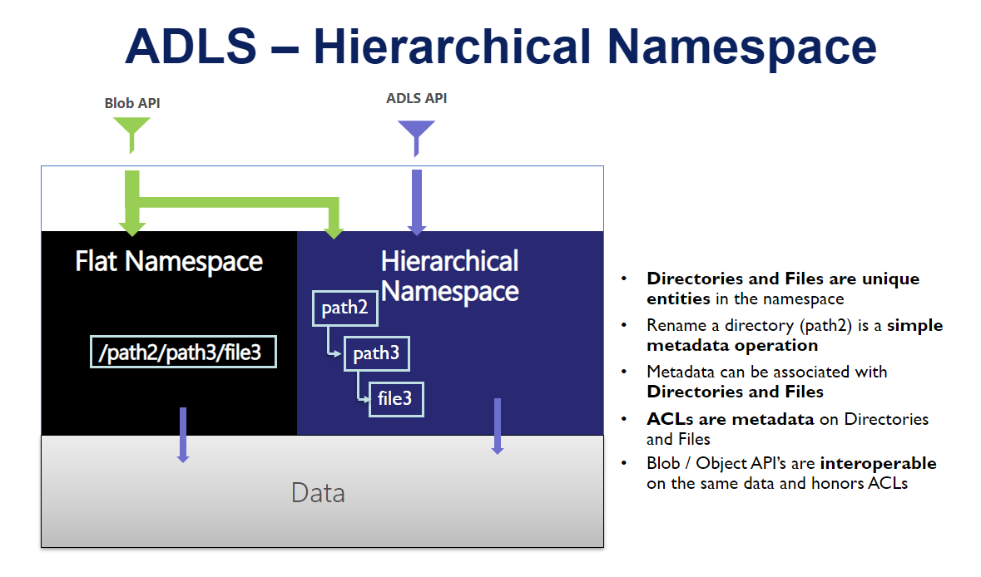

Slide 13
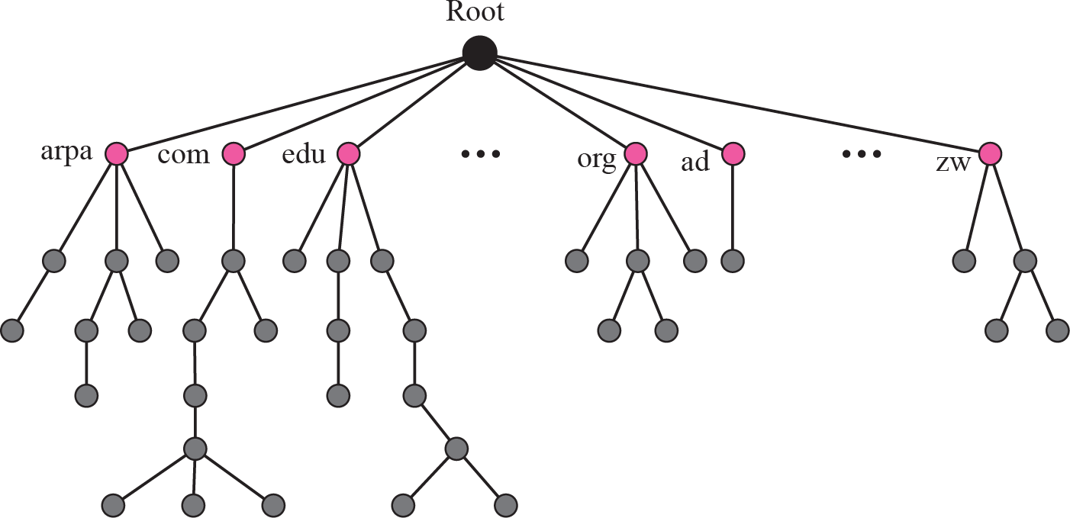

Slide 14
ROOT
DOMAIN NAME AND LABEL
VIT
vit.ac.in
INFO
WEBMAIL
VTOP
info.vit.ac.in
webmail.vit.ac.in
vtop.vit.ac.in

Slide 15
FQDN & PQDN
A fully qualified domain name (FQDN), sometimes also referred as an absolute
domain name, is a domain name that specifies its exact location in the tree hierarchy of the Domain Name System (DNS).
Domain
https://events.vit.ac.in.
Empty
(string represent the ROOT)
Academic Domain
Country Specific Domain
A subdomain under vit
DNS Domain names can contain characters "a to z", "A to Z", "0 to 9", and "-" (hyphen) only. Other common characters are not allowed.

Slide 16
FQDN & PQDN
A partially qualified domain name (PQDN) is a domain name that does not include all the levels between the host and the root node
A Partially Qualified Domain Name (PQDN) is used to specify a portion of a domain name, normally the host portion of it.
Example of Partially Qualified Domain Name (PQDN) vtop. Usually the computers will add the DNS suffix along with Partially Qualified Domain Name (PQDN) before sending a DNS query for name resolution.
Example : vtop

Slide 17
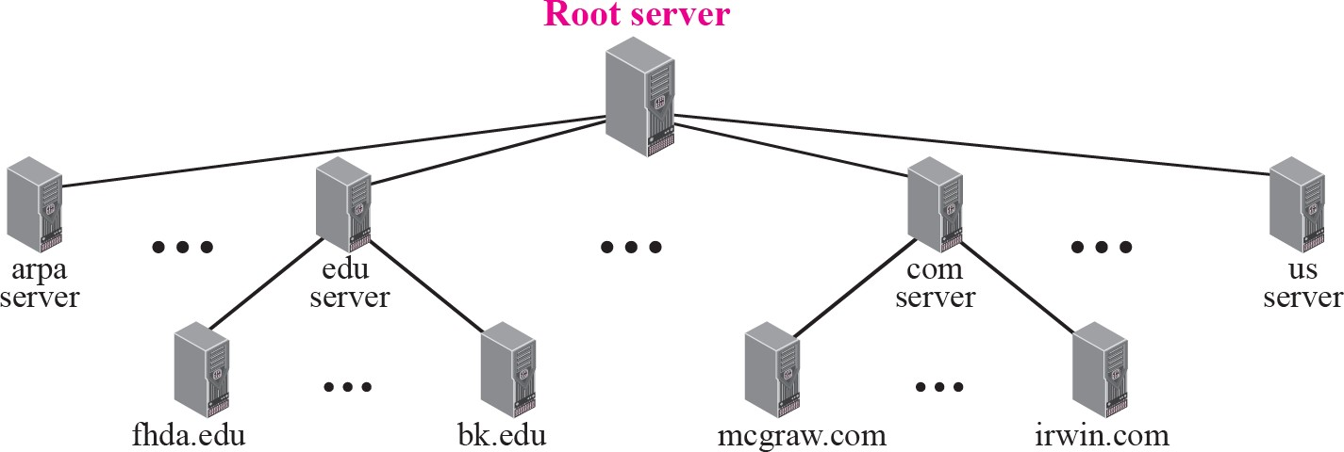
Hierarchy of name servers

Slide 18
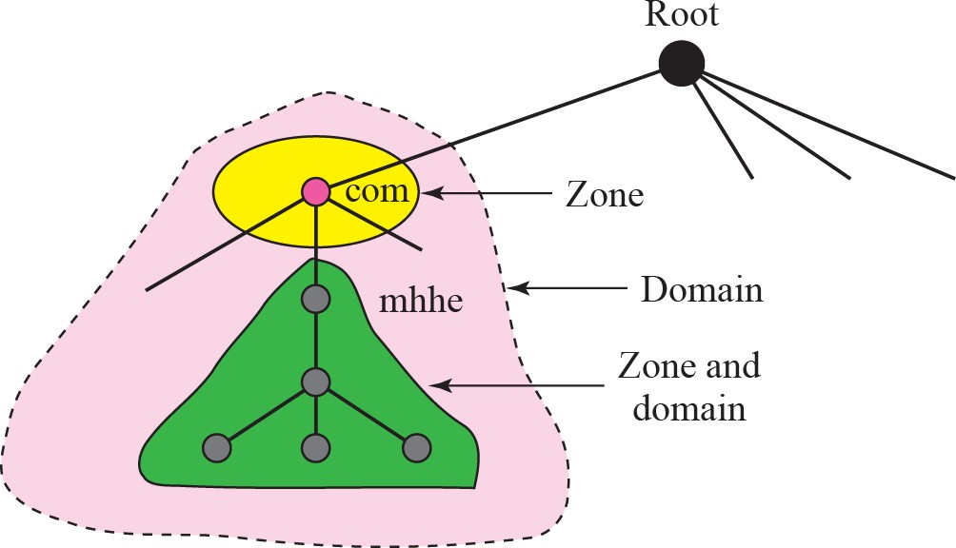
Zones and domains
DNS zone refers to a certain portion or administrative space within the global Domain Name System (DNS).
Each DNS zone represents a boundary of authority subject to management by certain entities.
The total of all DNS zones, which are organized in a hierarchical tree-like order of cascading lower-level domains, form the DNS namespace.

Slide 19
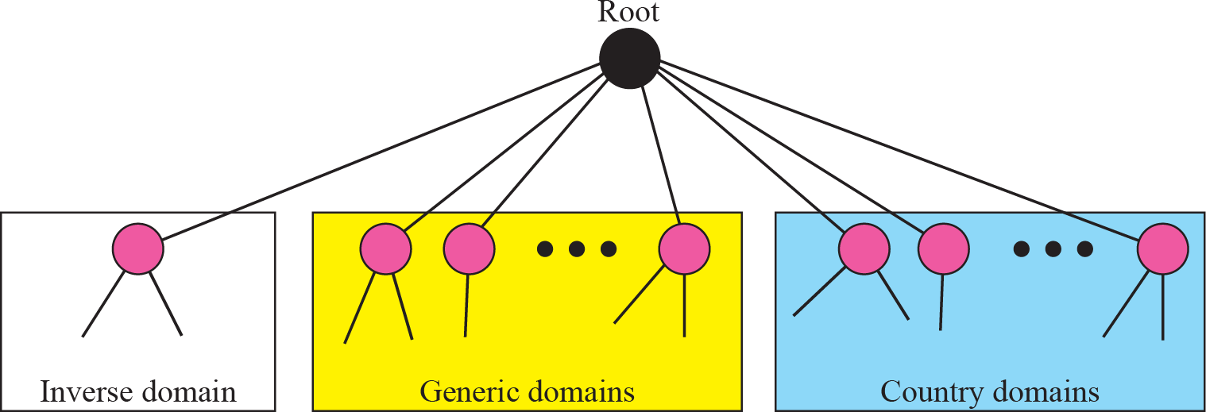
DNS IN THE INTERNET
DNS is a protocol that can be used in different platforms.
In the Internet, the domain name space (tree) is divided into three different sections:
Generic domains
Country domains
Inverse domain

Slide 20
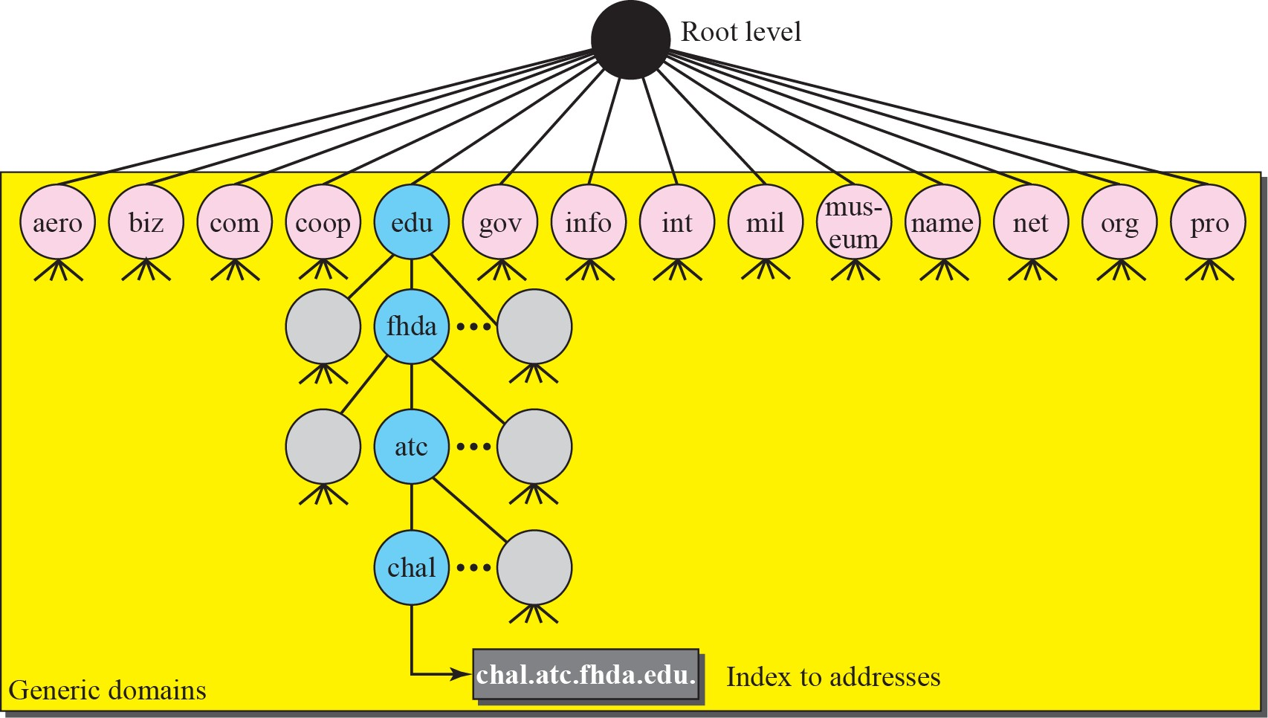
GENERIC DOMAINS

Slide 21
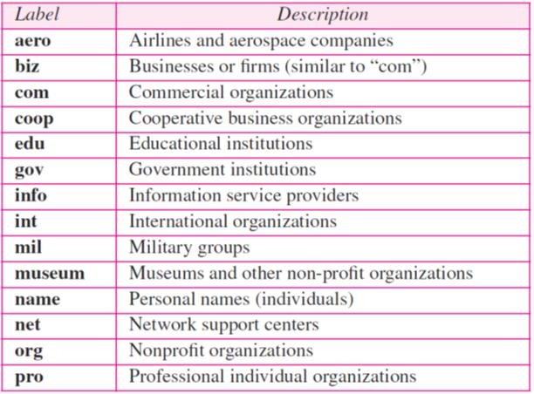
GENERIC DOMAINS

Slide 22
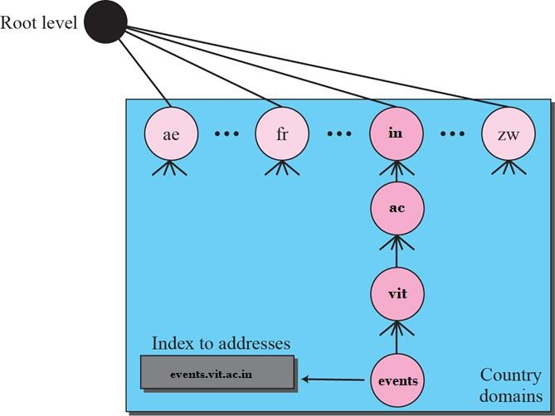
COUNTRY DOMAINS

Slide 23
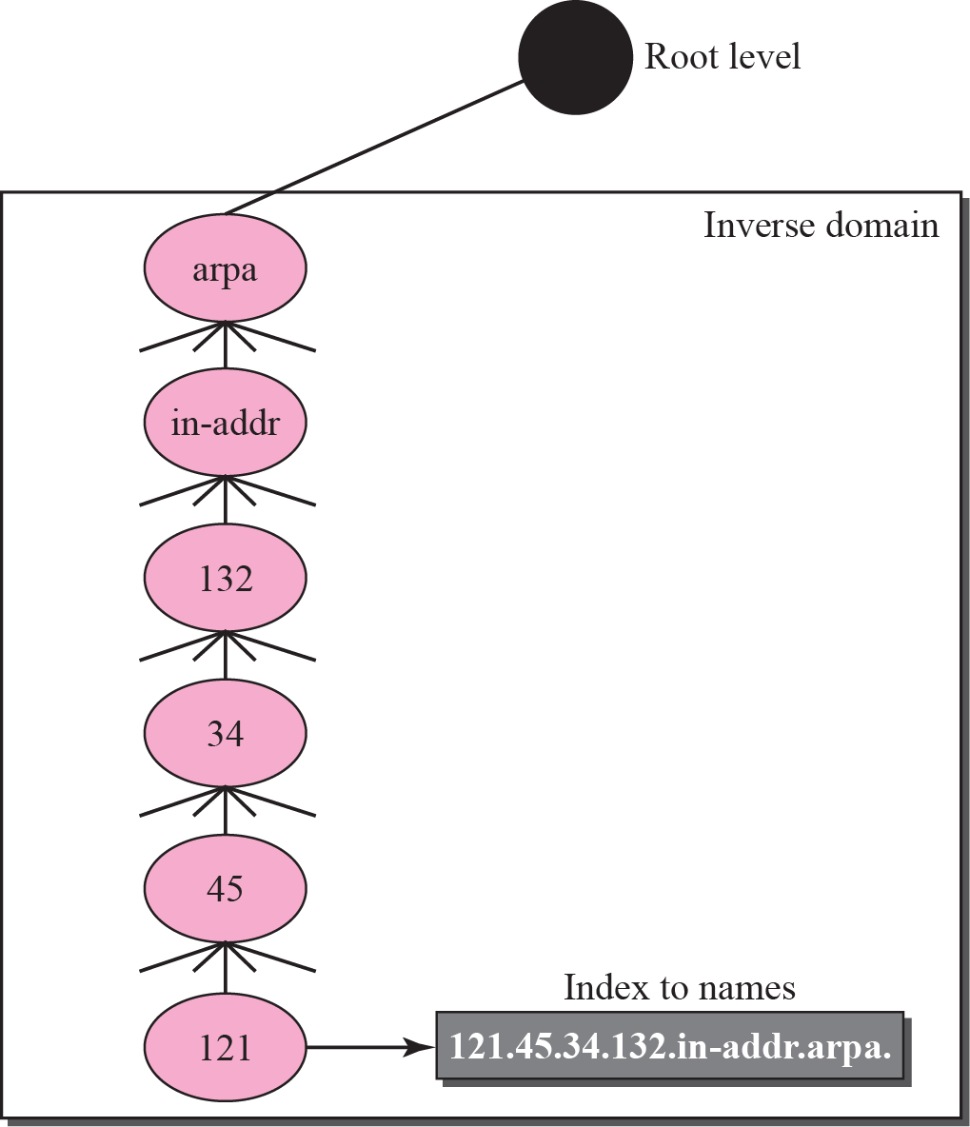
INVERSE DOMAIN

Slide 24
DNS RESOLUTION
Mapping a name to an address or an address to a name is called name-address resolution.
Resolver
Mapping Names to Addresses
Mapping Addresses to Names
Recursive Resolution
Iterative Resolution

Slide 25
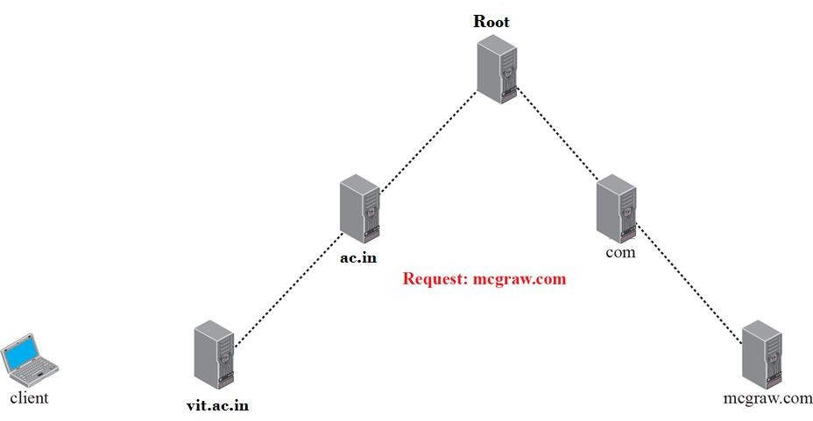










RECURSIVE RESOLUTION
3
4
8
7
2
5
9
6
1
10

Slide 26










ITERATIVE RESOLUTION
5
6
3
4
1
2
7
8
9
10

Slide 27
DNS MESSAGES
DNS has two types of messages:
Query
Response.
Both types have the same format.
The query message consists of a header and question records.
The response message consists of a header, question records, answer records, authoritative records, and additional records.

Slide 28

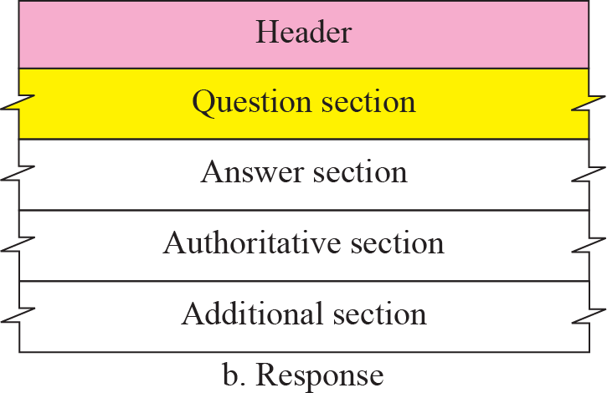
QUERY AND RESPONSE MESSAGES

Slide 29
TYPES OF RECORDS
As we saw in the previous section, two types of records are used in DNS. The question records are used in the question section of the query and response messages. The resource records are used in the answer, authoritative, and additional information sections of the response message.
Question Record
Resource Record

Slide 30

QUESTION RECORD FORMAT

Slide 31
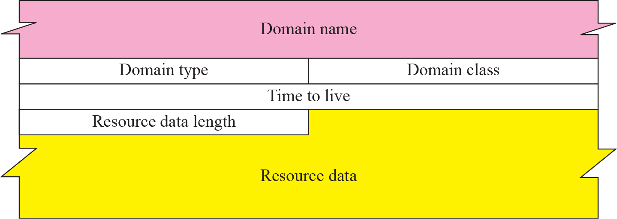
RESOURCE RECORD FORMAT

Slide 32
REGISTRARS
How are new domains added to DNS? This is done through a registrar, a commercial entity accredited by ICANN. A registrar first verifies that the requested domain name is unique and then enters it into the DNS database. A fee is charged.
ICANN - Internet Corporation for Assigned Names and Numbers

Slide 33
DDNS
In DNS, when there is a change, such as
adding a new host
removing a host
changing an IP address
The change must be made to the DNS master file.
The DNSZmaster file must be updated dynamically.
The Dynamic Domain Name System (DDNS) therefore was devised
to respond to this need.

Slide 34
SECURITY OF DNS
DNS is one
of the most important systems in the Internet
infrastructure;
Applications such as Web access or e-mail are heavily dependent on
the proper operation of DNS.
DNS can be attacked in several Ways.
To protect DNS, IETF has devised a technology named DNS
Security
(DNSSEC) that provides the message origin authentication and
message integrity using a security service called Digital signature

